Slide 1

Pneumonia Detection using image based Deep Learning
By :-
Apoorv Khare (9917102079)
vivek Garg
(9917102068)
Sourabh Kumar
(9917102015)

Slide 2
Introduction to Deep learning
Deep learning is an artificial intelligence function that imitates the workings of the human brain in processing data and creating patterns for use in decision making. Deep learning is a subset of machine learning in artificial intelligence (AI) that has networks capable of learning unsupervised from data that is unstructured or unlabeled. Also known as deep neural learning or deep neural network.
Deep learning has evolved hand-in-hand with the digital era, which has brought about an explosion of data in all forms and from every region of the world. This data, known simply as big data, is drawn from sources like social media, internet search engines, e-commerce platforms, and online cinemas, among others. This enormous amount of data is readily accessible and can be shared through fintech applications like cloud computing.

Slide 3
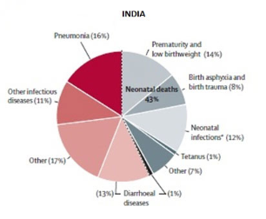
Identifying the problem:- Pneumonia
Pneumonia is a form of acute respiratory infection that affects the lungs. The lungs are made up of small sacs called alveoli, which fill with air when a healthy person breathes. When an individual has pneumonia, the alveoli are filled with pus and fluid, which makes breathing painful and limits oxygen intake.
Pneumonia accounts for 15% of all deaths of children under 5 years old, killing 808,694 children in 2017.
Pneumonia can be caused by viruses, bacteria, or fungi.
Pneumonia can be prevented by immunization, adequate nutrition, and by addressing environmental factors.
Pneumonia caused by bacteria can be treated with antibiotics, but only one third of children with pneumonia receive the antibiotics they need.
Through our project we tend to classify the chest X-rays and improve accuracy to help detect the Bacterial pneumonia as well as Viral pneumonia

Slide 4
Flow chart
Data Extraction and Visualization of Chest X-rays
Splitting the data into train,test and validation folder and visualization of the chest x-rays.
Data preprocessing And Augmentation
We normalize the images and perform image augmentation techniques.
We extract the features from x-ray using CNN and feed these features to ANN.
Feature Extraction using Custom CNN and ANN
Training and Testing of the Model
The model is trained on train dataset and simultaneously tested using validation dataset.
Evaluation of the Trained Model
Model is evaluated using RoC curve and confusion matrix.
Also Heatmap is plot on the predicted image to see what features our model is learning.

Slide 5
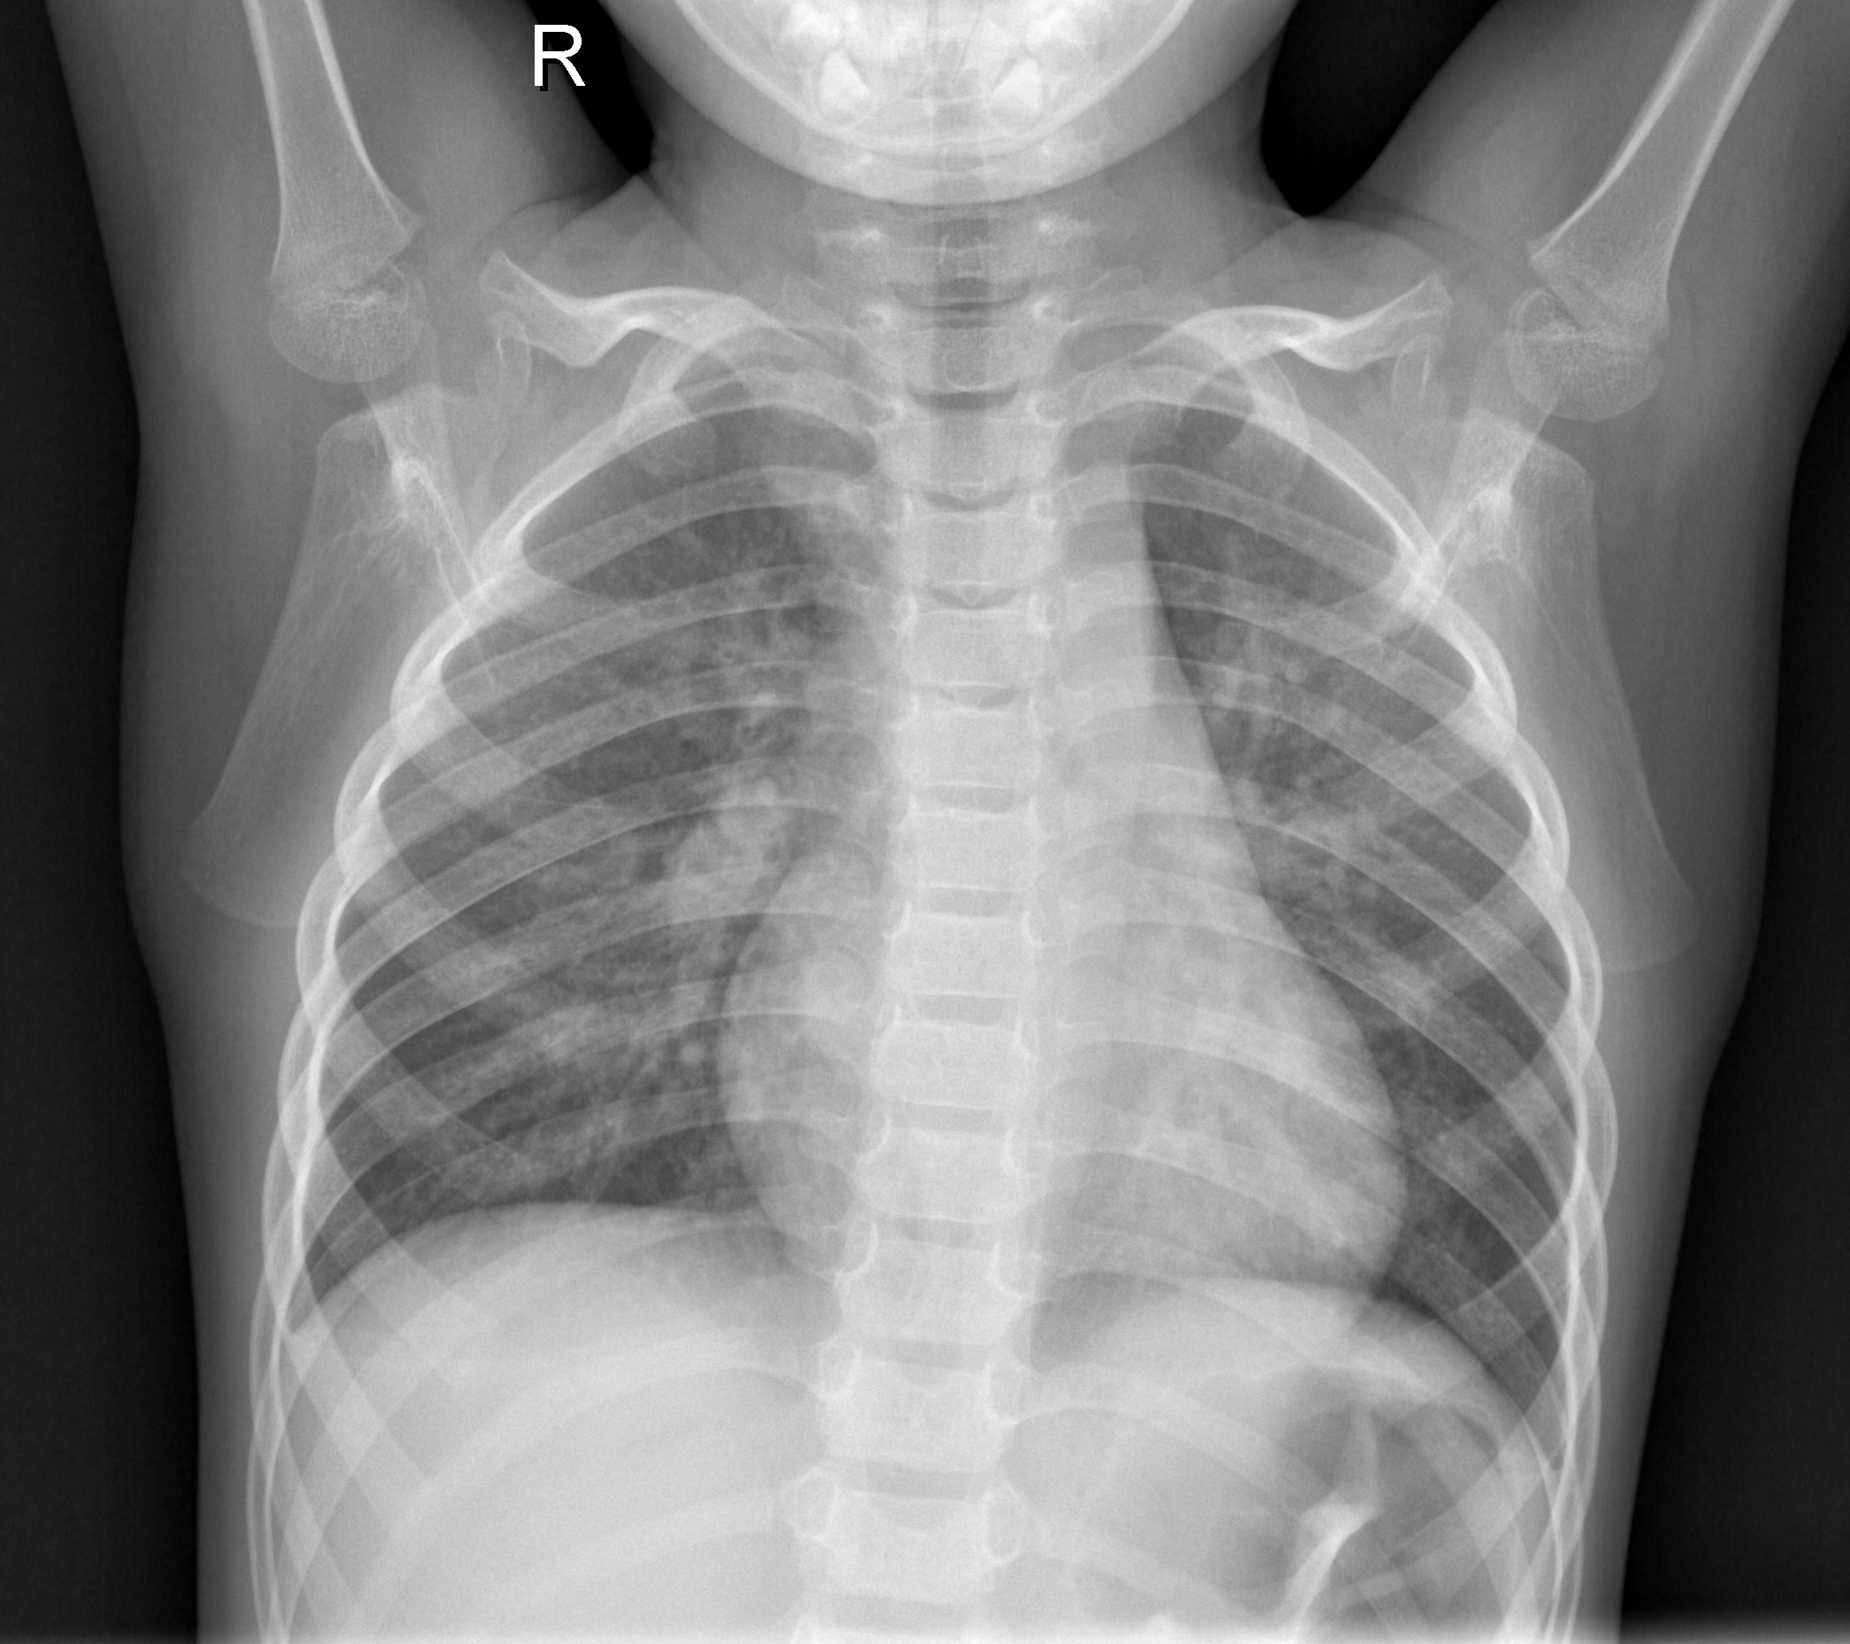
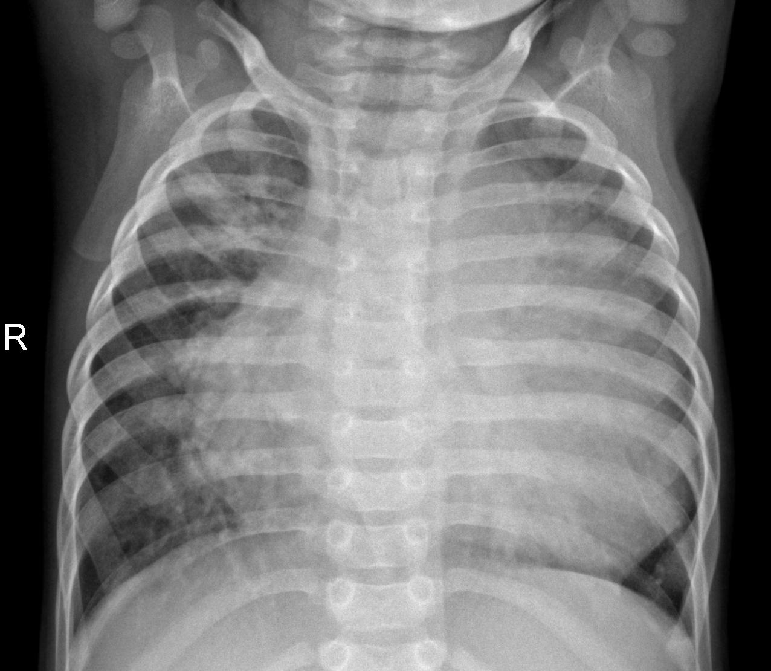
Database
Among multiple datasets available on net like RSNA,CheXNet etc we have selected Paul Mooney Dataset due to its high credibility.
The dataset is organized into 3 folders (train, test, val) and contains subfolders for each image category (Pneumonia/Normal). There are 5,863 X-Ray images (JPEG) and 2 categories (Pneumonia/Normal).
Chest X-ray images (anterior-posterior) were selected from retrospective cohorts of pediatric patients of one to five years old from Guangzhou Women and Children’s Medical Center, Guangzhou. All chest X-ray imaging was performed as part of patients’ routine clinical care.
This dataset is freely available for research purposes. In June 2017 Mendeley awarded by Data Seal of Approval which indicates, this data is retrieved from trustworthy sources.
Person without Pneumonia
Person with Pneumonia

Slide 6
Data augmentation
Data augmentation is a strategy that enables practitioners to significantly increase the diversity of data available for training models, without actually collecting new data.
Data augmentation techniques such as cropping, padding, and horizontal flipping are commonly used to train large neural networks. However, most approaches used in training neural networks only use basic types of augmentation. While neural network architectures have been investigated in depth, less focus has been put into discovering strong types of data augmentation and data augmentation policies that capture data invariances.
Deep Neural network model on a large number of data can help to increase the accuracy of the result and the data augmentation technique can create the modified version of same data.

Slide 7
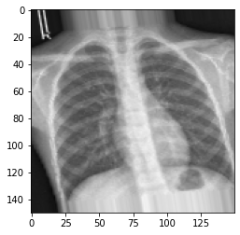
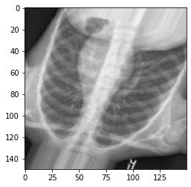
Data AUGMENTED images
Dataset’s Actual X-Ray Image
Data-Augmented Image

Slide 8
Convolutional Neural Networks(cnn)
Convolutional Neural Networks are very similar to ordinary Neural Network. Each neuron receives some inputs, performs a dot product and optionally follows it with a non-linearity.
Each hidden layer is made up of a set of neurons, where each neuron is fully connected to all neurons in the previous layer, and where neurons in a single layer function completely independently and do not share any connections. The last fully-connected layer is called the “output layer” and in classification settings it represents the class scores.

Slide 9
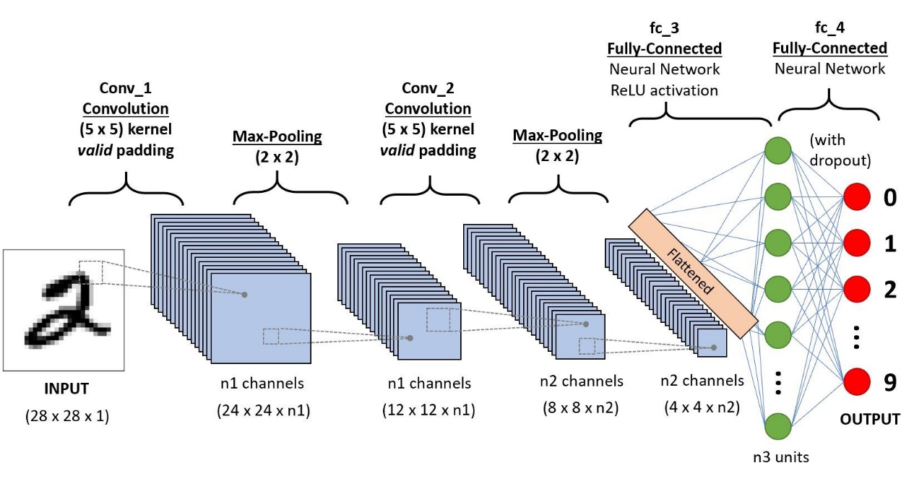
CNN architecture
Architecture of Convolution Neural Network

Slide 10
Convolution Layers
A CNN is composed of several kinds of layers:
Convolutional layer: Creates a feature map to predict the class probabilities for each feature by applying a filter that scans the whole image, few pixels at a time.
Pooling layer (down sampling): Scales down the amount of information the convolutional layer generated for each feature and maintains the most essential information (the process of the convolutional and pooling layers usually repeats several times).
Fully connected input layer: It “flattens” the outputs generated by previous layers to turn them into a single vector that can be used as an input for the next layer.
Fully connected layer: Applies weights over the input generated by the feature analysis to predict an accurate label.
Fully connected output layer: Generates the final probabilities to determine a class for the image.

Slide 11
Custom- CNN Model
A Custom Convolution Neural Networks is a type of artificial neural network that
does not use pre-trained models like Inception, VGG 16 etc to recognize a variety
of features.
Custom Convolution Neural Networks can help in reducing complexity as well as
improve accuracy.
It is also used to reduce overfitting of data.
We have used a five-layer custom convolution network.
Each layer is composed of multiple convolution layer and a pooling layer.

Slide 12
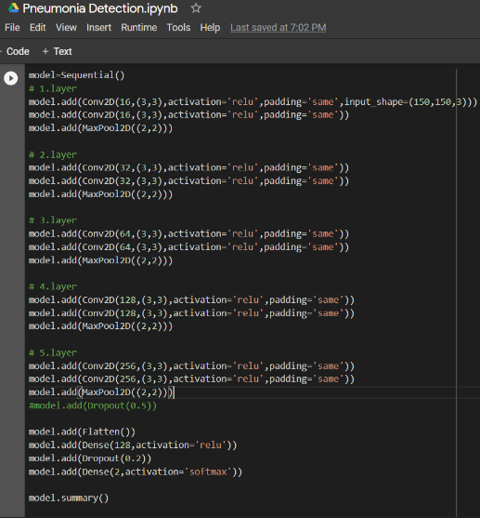
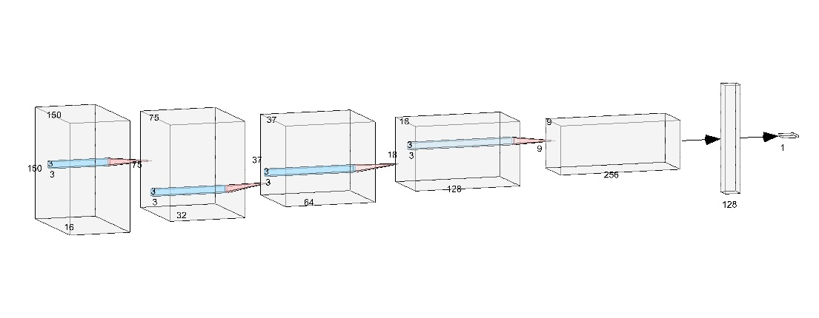
Model Diagram
Custom–CNN Model Creation

Slide 13
Result Analysis
In this project, we have used 2 different type of CNN models in Classification of Dataset.
They are:-
Pretrained VGG16 model
Custom-CNN Model
Also we have used method like ROC and Confusion matrix and Grad-CAM methods to diagnose the ability of the CNN model in prediction of Normal and Pneumonia.

Slide 14
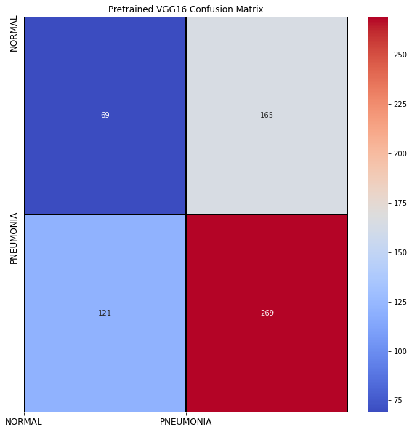
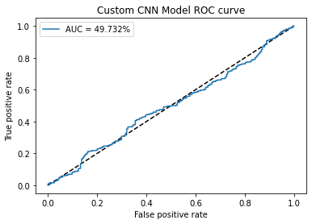
Pretrained VGG16 Model
Accuracy Obtained :- 90.70%
Confusion Matrix
ROC Curve

Slide 15
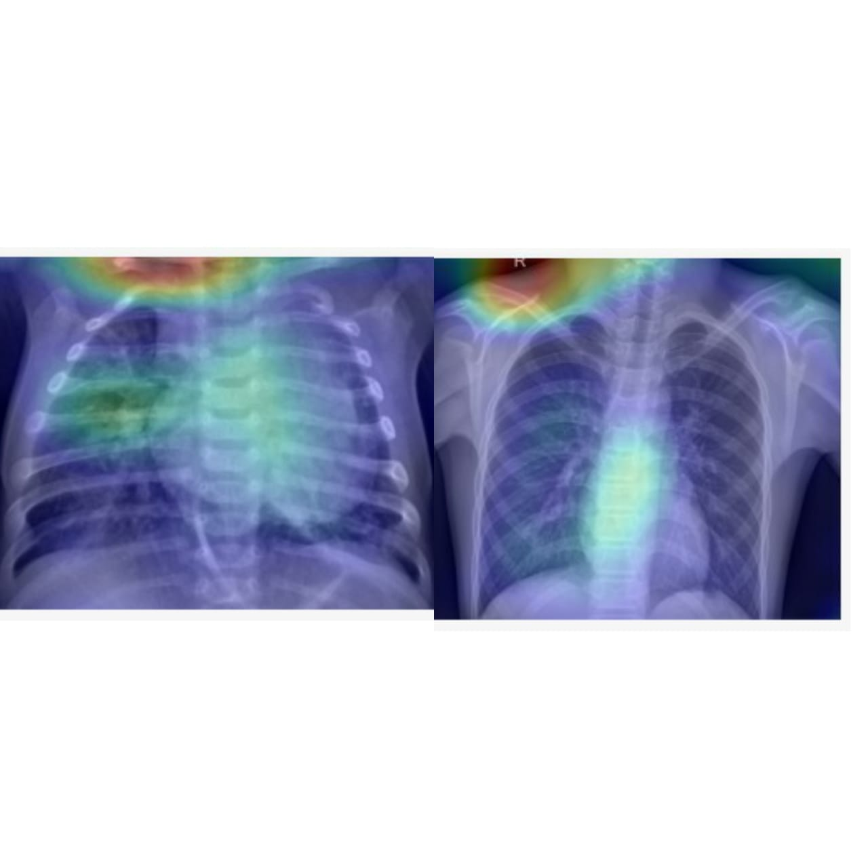
Verification - Grad-Cam output
Showing Grad-Cam output on VGG16 model. Left predicting Pneumonia And right predicting Normal

Slide 16
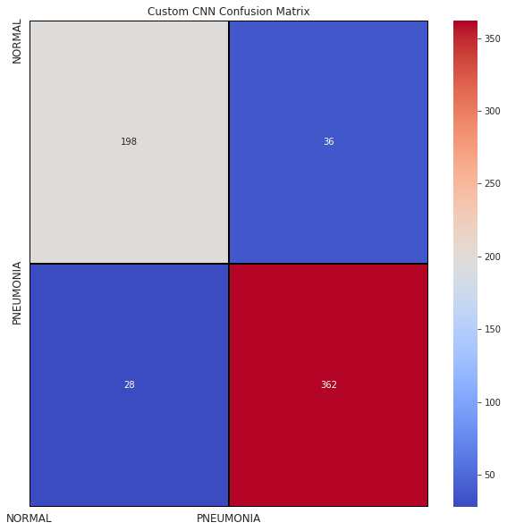
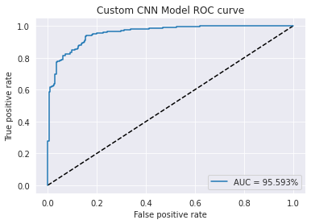
Custom CNN model
Accuracy Obtained - 89.743%
Confusion Matrix
ROC curve

Slide 17
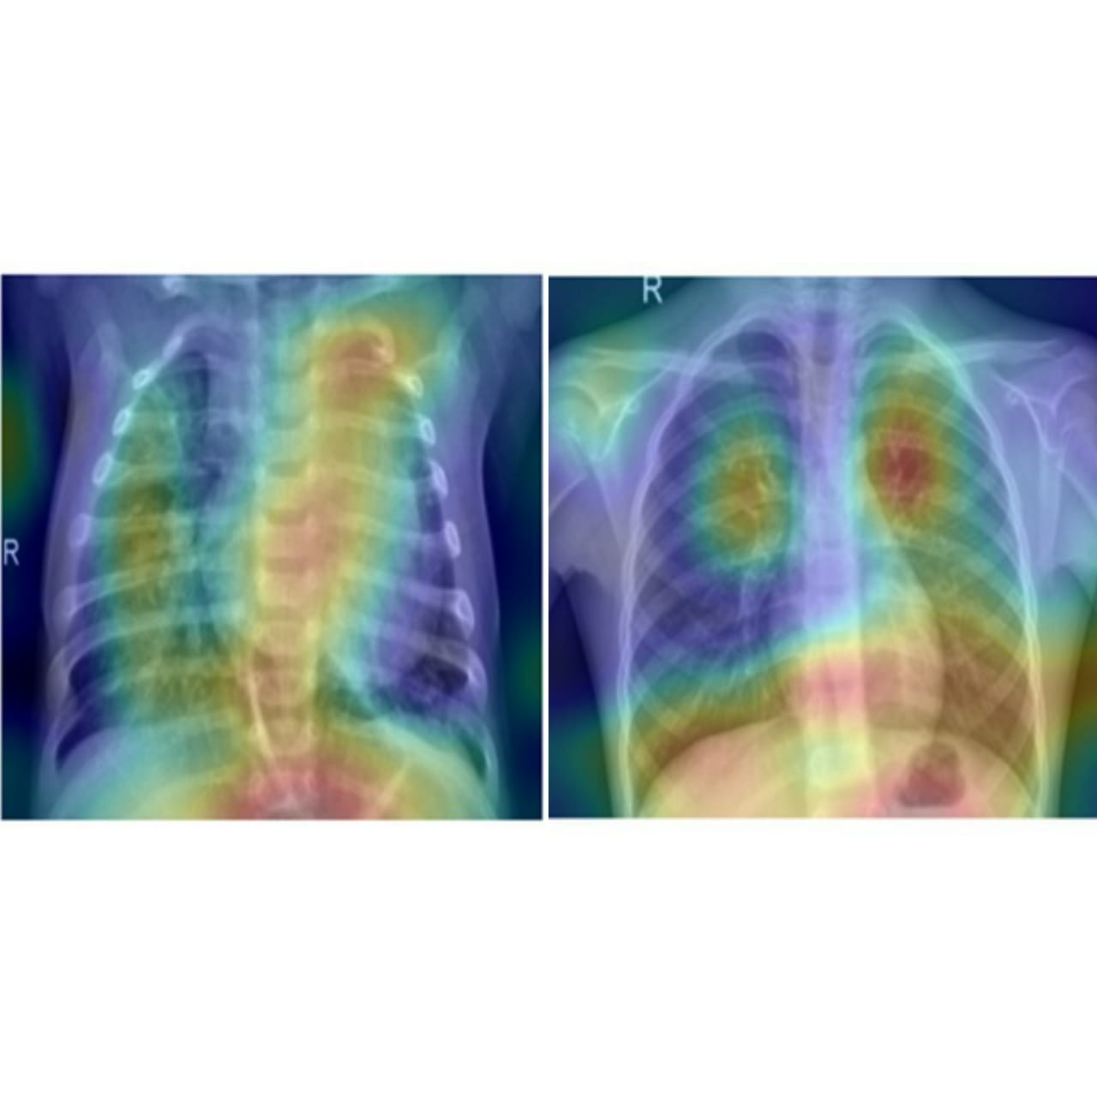
Verification - Grad-Cam output
Showing Grad-Cam output on Custom CNN model. Left predicting Pneumonia And right predicting Normal

Slide 18
Discussion of Results
By seeing the above Matrix, we came to know how much confuse the model is while classifying between Normal and Pneumonia. The Custom CNN model is showing much less confusion than the VGG16 model. And this confusion in VGG16 is due to low precision and recall values. Also, this VGG16 model used is trained on ImageNet dataset and the dataset used here in this model is out of its scope. Since we know our Deep Learning model are very sensitive to data.
In the above results we conclude that the ROC-AUC of the VGG16 is not up to mark as expected. Though test accuracy of VGG16 is 90.70% but the actual accuracy obtained is 50-60%. Whereas in Custom CNN our model testing accuracy and actually obtained are approximately 90%.
From above figures we can exactly see what features our model is seeing while predicting Normal or Pneumonia. Grad-CAM of Custom CNN is up to the mark it is trying to see inflammation in lungs. But in VGG16 our model is lying more importance to shoulder area than lungs. Thus, from this we can see why VGG16 is randomly predicting.

Slide 19
Conclusion and future scope
From above results, we conclude that though Custom CNN shows very good actual performance as compared to Pretrained model. Also we came to know faults in our model that caused low accuracy in Pretrained model also we came across the term Class imbalance which affected our model accuracy but in case of Custom CNN model its effect was negligible. Also Grad-Cam helped us to visualize the model and its performance.
In future, we can expand our model to detect multiple disease like Covid-19, Pneumothorax, Atelectasis, Cardiomegaly, Infiltration, etc. from Chest X-ray analysis.
Also, we can use some pretrained models like ResNet50, Inception V3, VGG19, etc. to save time and can have better accuracy. Also, we can research to reduce the false positive and false negative of the model in order to make the model marketable.
We can work on class imbalance problem which caused so much error in pretrained models while predicting.

Slide 20
References
[1] Heron, M. “National Vital Statistics Reports” Volume 67, Number 5 July 26, 2018, National Vital Statistics Reports 67(6): 1-15.
[2] Liang, G. and Zheng, L. “A transfer learning method with deep residual network for paediatric pneumonia diagnosis”, Computer Methods and Programs in Biomedicine 2019.
[3] Simonyan, K. and Zisserman, A. “Very deep convolutional networks for large-scale image recognition”, 3rd International Conference on Learning Representations, ICLR 2015 - Conference Track Proceedings pp. 1-14.
[4] S. R. Islam, S. P. Maity, A. K. Ray and M. Mandal, "Automatic Detection of Pneumonia on Compressed Sensing Images using Deep Learning," IEEE Canadian Conference of Electrical and Computer Engineering (CCECE), Edmonton, AB, Canada, 2019, pp. 1-4.
[5] Ismail, Azlan; Rahmat, Taufik; ALIMAN, Sharifah. “Chest X-Ray Image Classification using Faster R-CNN”. Malaysian journal of computing, [S.l.], v. 4, n. 1, p. 225-236, July
2019. ISSN 2600-8238
[6] Liu, H., Wang, L., Nan, Y., Jin, F., Wang, Q. and Pu, J. “SDFN: Segmentation based deep fusion network for thoracic disease classification in chest X-ray images”, Computerized Medical Imaging and Graphics ,2019, 75: 66-73.
[7] Pan, I., Agarwal, S. and Merck, D. “Generalizable Inter-Institutional Classification of Abnormal Chest Radiographs Using Efficient Convolutional Neural Networks”, Journal of
Digital Imaging, 2019, 32(5): 888-896.
[8] Heo, S. J., Kim, Y., Yun, S., Lim, S. S., Kim, J., Nam, C. M., Park, E. C., Jung, I. and Yoon, J. H. “Deep learning algorithms with demographic information help to detect tuberculosis in chest radiographs in annual workers' health examination data”, International Journal of Environmental Research and Public Health,2019.

Slide 21
THANK YOU!!

